Slide 1
Codenvy v4.7
ACE (don’t need to create Oracle manually)
By Andrey Solodov
Skype: andrey.solodov_1
Email: andrey.solodov@aurea.com

Slide 2
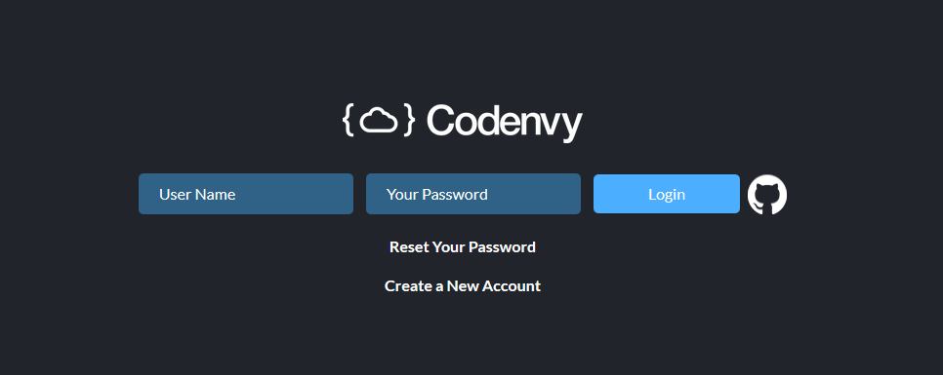
Logging in
In order to log in you have to be connected to Aurea VPN (vpn.aurea.com).
Then follow the link http://codenvy.aurea.local/f?id=0fcsv34v9lu28t6y
You will see log-in window. Please use your credentials that i sent to everyone of you.
Please set up the new password in the profile!!!

Slide 3
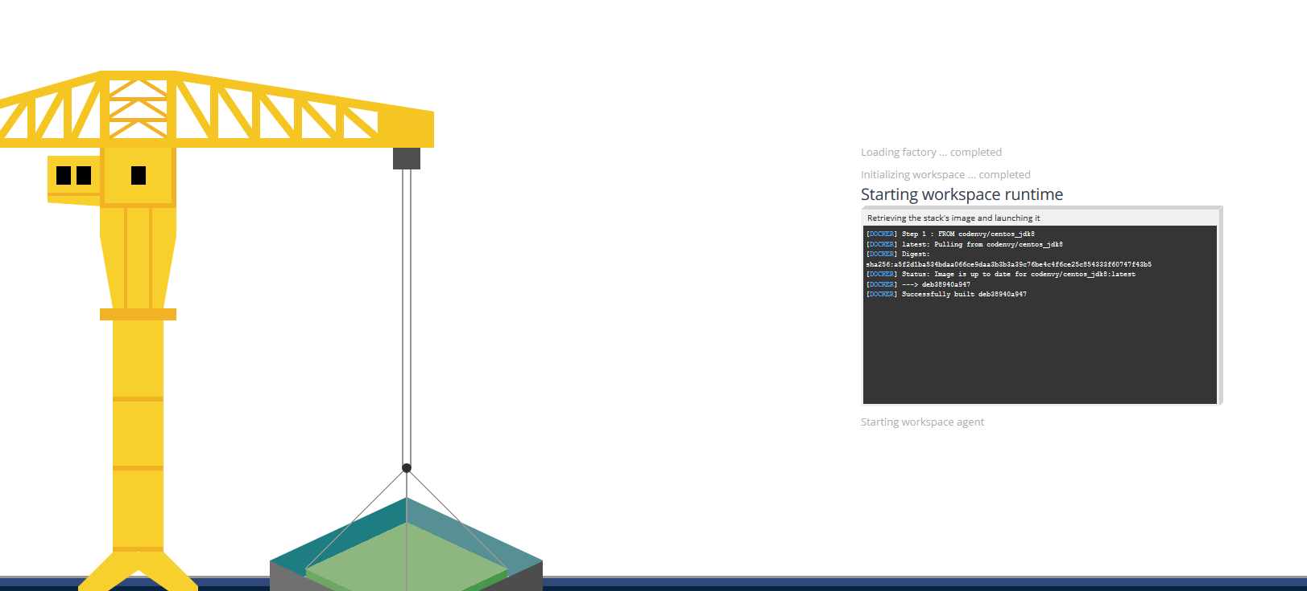
Workspace is creating
When you clicked the link smth interesting has happened. After i configured the project inside Codenvy i created a Factory.
A Factory allowed me to provide you with a link that will create the exact copy of my configured ACE workspace. Workspace is a main concept in Codenvy, in the high level it’s a thing that contains source code, runtime and can contain many different machines required for building/running the product. On the lower level workspace is a running Docker container with some default services required for Codenvy itself (like Apache TomCat) and services specific to the project (like Ant for building the code)

Slide 4
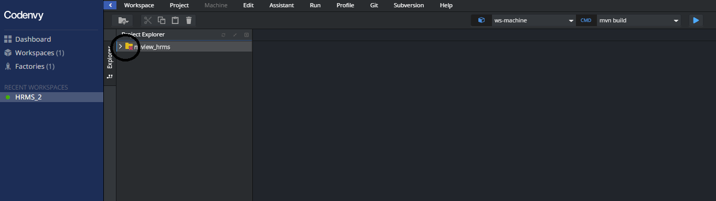
Checking out codebase
The next thing you should do after the workspace is created is to create SSH key-pair and add public key to your Bitbucket account.
This red cross icon shows you that the code for project (here nuview_hrms) was not checked out yet. Let’s create a key pair.

Slide 5
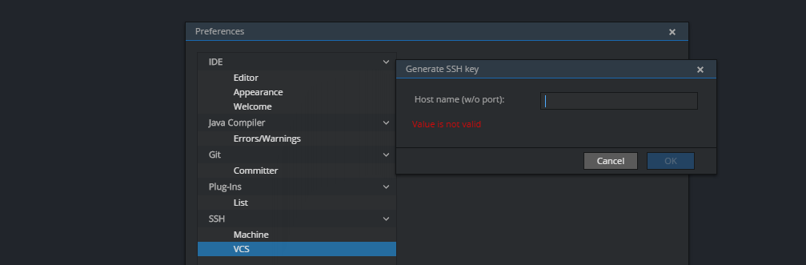

SSH Keys
You need to go to Profile->Preferences->VCS->Generate key
In the hostname type scm.devfactory.com and click OK. You have your key added.
Click on View, copy the key

Slide 6
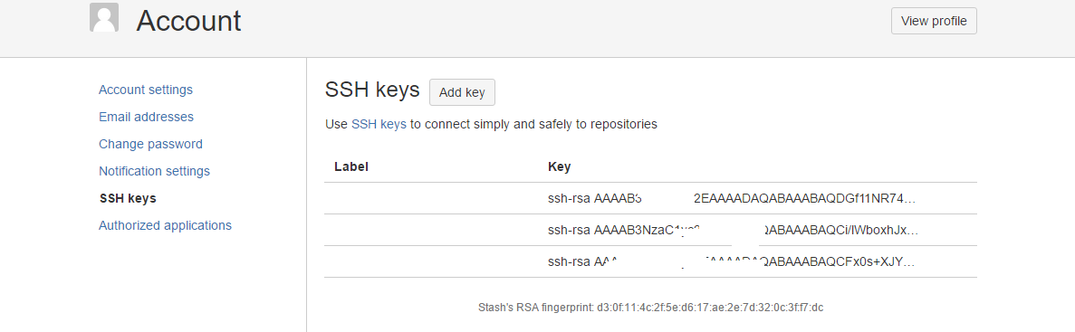
SSH Keys (continue)
Add the key into you Stash account. Please make sure that you have not pasted the key at Bitbucket with the whitespace at the end.

Slide 7
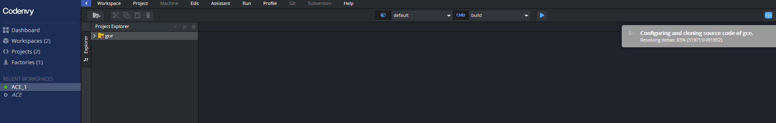
Cloning the code
Then Stop and Start the workspace. The code will be cloned. If it’s not cloned, stop/delete this workspace and create a new one following the link from slide 2.
So the workspace can contain project. You can import project from VCS, GitHub, ZIP. OR you can create files yourself.
Every project source files exist in two places: inside Codenvy server and inside workspace (container) (go ahead and do cd /projects to see it).
Workspace can have 2 states: running and stopped.
When you stop the workspace docker container is destroyed, everything you installed inside this container will be lost (if you didn’t create a snapshot for this), BUT everything you did inside your codebase will be safe as the next time you start the workspace Codenvy will inject to this workspace the project code from Codenvy server (Docker volumes make this happen).

Slide 8
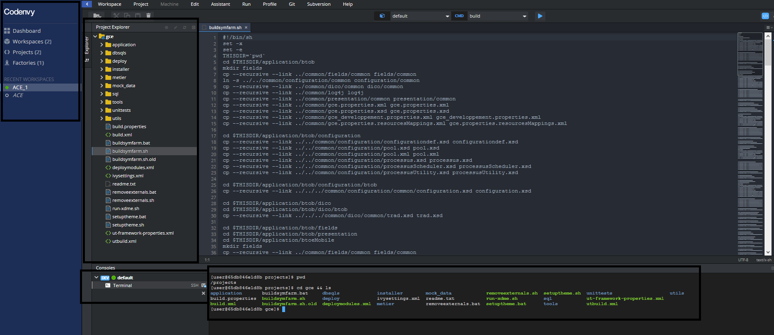
Interface
Okay, code has been checked out. Now we can see Codenvy GUI, We can see one sidebar on the left and the main screen area consisting of project tree, IDE editor, and JavaScript console (cool thing, by the way every prebuilt workspace have Midnight Commander, go ahead and enjoy it running mc)

Slide 9
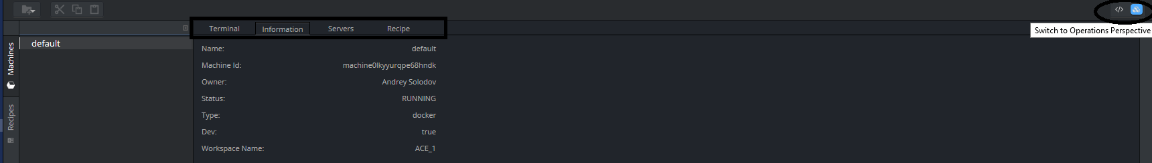
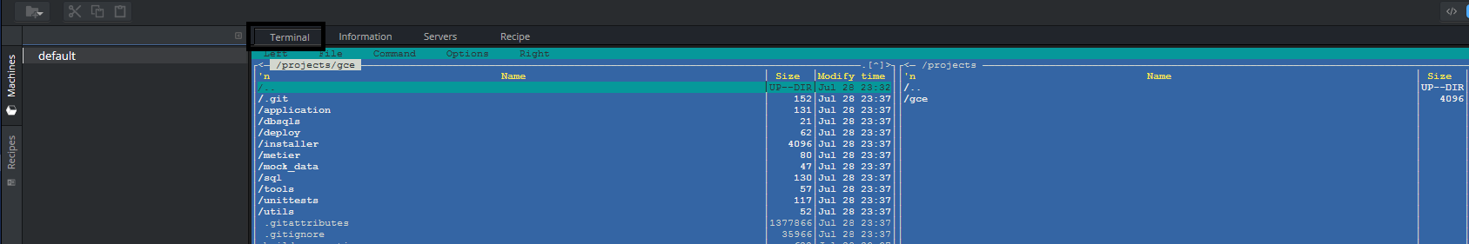
Workspace nuts and bolts...
To see a lot of interesting and IMPORTANT information about a workspace you have to switch to Operations perspective (see the icon on the top right corner). Here we can see 4 tabs: Terminal, Information, Servers, Recipe.
Information tab contains machine name (well, workspace is a machine), ID, etc
Terminal tab is a Java Script terminal to the machine (here I ran mc).

Slide 10
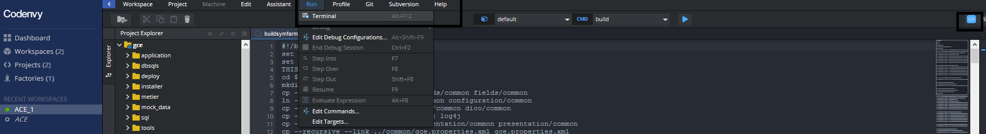
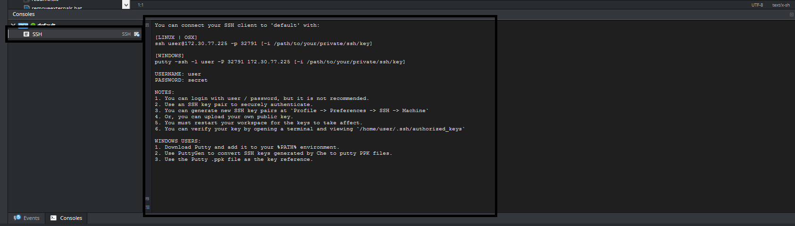
Terminal
Terminal is AWESOME. Let’s talk about it a bit more and i’ll show you some cool things.
Actually if you can’t see a terminal window on you Project Perspective just go to Terminal window and run it.
Or you can SSH to that container (that’s huge)... Just press on SSH to see the details.

Slide 11
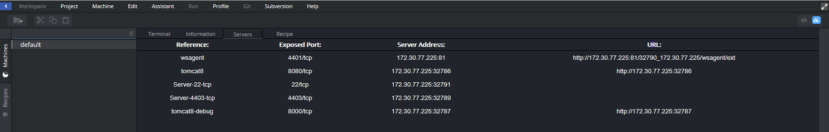
Ports
Let’s switch back to Operations Perspective and investigate very important Servers tab.
Well, every workspace is built from image that as i already mentioned has some preinstalled services that allow to intercommunicate Codenvy server and workspace. These services has exposed ports that are randomly mapping to Codenvy server ports range 32768-65535.
This tab is important and useful tool when you are going to see the result of your build process

Slide 12
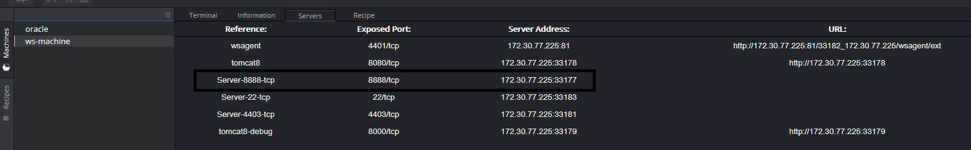
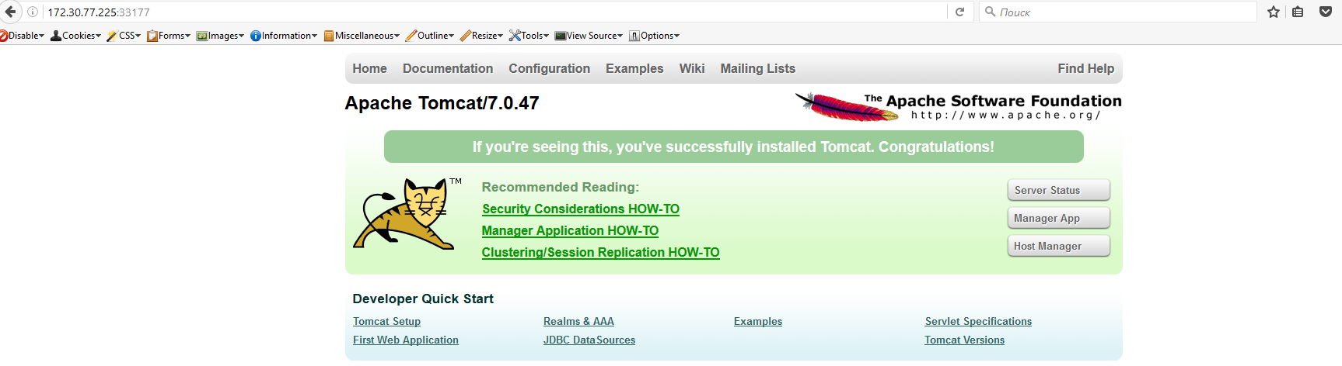
Multi-machine environment
Now i have 2 machines in my workspace: ws-machine (the 1st one that was created during workspace creation) and oracle. You can connect a terminal to each of them, see exposed ports, etc. For example here i can go to http://172.30.77.225:33177 (exposed 8888) and will see ACE custom Apache TomCat (remember that port number will differ from mine), in order to see the Apache TomCat home page you need to start it cd /home/egx/tomcat-ace-embedded-200 && ./on.sh

Slide 13
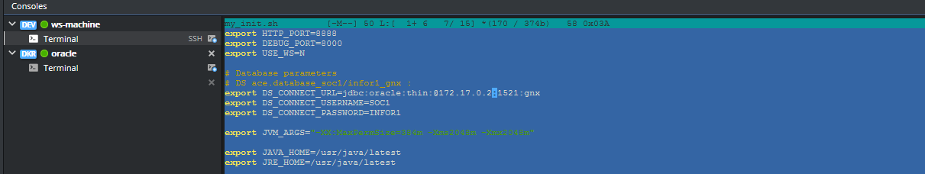
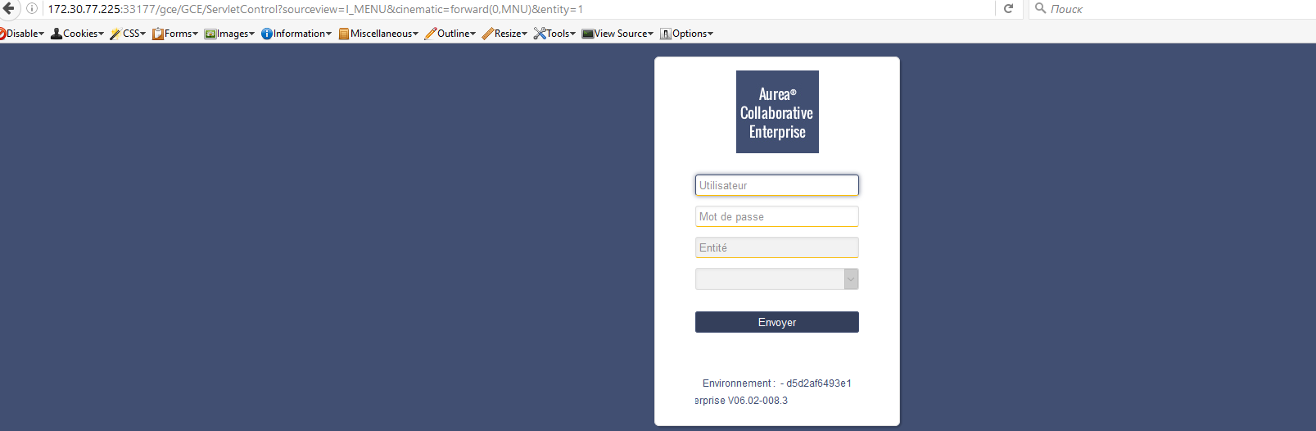
ACE running
After i did some customization in my_init.sh file inside ws-machine (the one thing you have to change is the connection string to oracle server, just use ip of oracle container (ifconfig inside oracle terminal) instead of localhost) i can see actual ACE app on the screen.Use vi editor to edit the files inside the terminal. This is the command sequence. cd /home/egx/tomcat-ace-embedded-200; sudo ./off.sh; vi my_init.sh; sudo ./on.sh

Slide 14
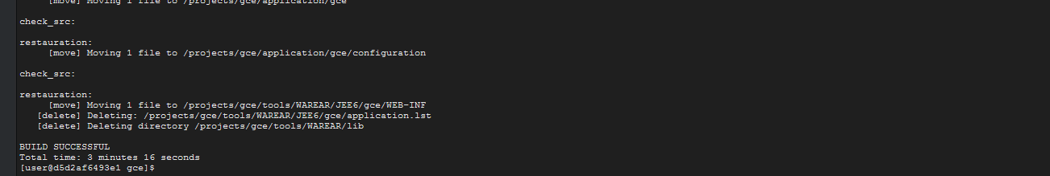
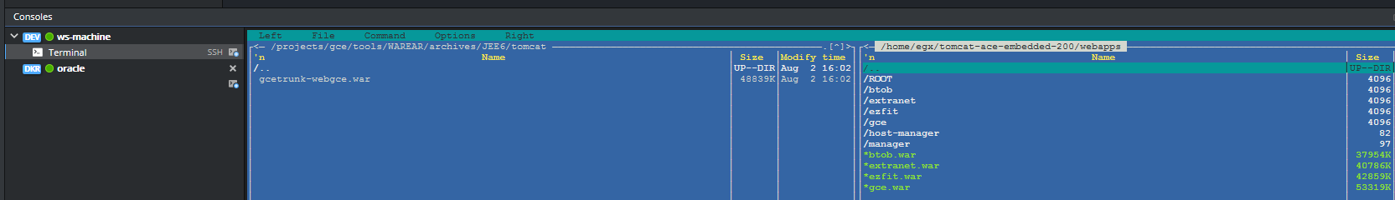
Building the product.
In order to build the product do: cd /projects/gce && ant main.gce
After that all you have to do is to copy generated .war file to /home/egx/tomcat-embedded-200/webapps. Use mc for simplicity.
Then go ahead and check the result in the browser (probably will need to restart Apache TomCat)

Slide 15
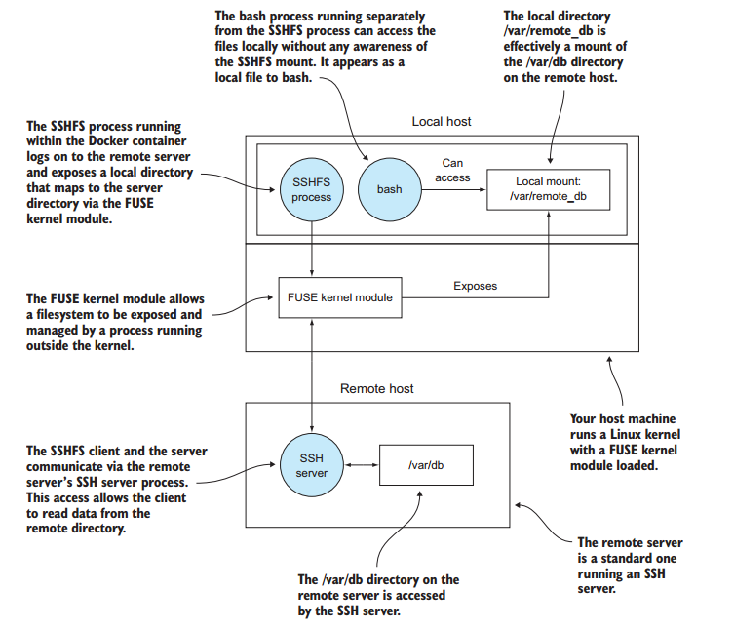
SSH to local IDE
To create SSH connection to your local IDE please follow the link:
http://codenvy.readme.io/v4.4/docs/using-desktop-ides
It’s really simple and working on every platform (Mac, Linux, Windows). It uses sshfs, so be informed that this solution doesn’t clone the contents from Codenvy server. It mounts it. So when you close sshfs connection the local folder where you’ve mounted your sources from Codenvy server will be empty. I showed the mechanics for those interested ================================>

Slide 16
Debugging
Please check debugging docs following the link
https://eclipse-che.readme.io/docs/debug

